Slide 1





PRESENTATION 2026
Student Name
Student Email
Radhika Gohel
gohel.radhika498.gmail.com
Mentor Name
Ms. Jyoti

Slide 2

Outline
Abstract of the Project
Problem Statement
Proposed Solution
System Architecture
Live Demo of the Project
Embedded Video of Project
Conclusion
Future Scope

Slide 3
Abstract
Overview: Bridges quantitative analytics with qualitative content generation.
Objective: Transform Global YouTube Statistics into data-backed marketing copy.
Tools: Power BI, Microsoft Copilot, Power Query, GitHub.
Outcome: A validated pipeline producing specialized scripts and social media assets based on real-world performance KPIs.

Slide 4

Problem Statement
Core Issue: Organizations possess massive data but lack the prompt engineering skills to use it effectively with Generative AI.
Challenge: Generic AI usage produces generic content that ignores specific audience metrics.
Impact: Marketing agencies and creators suffer from inefficient workflows and low-engagement creative outputs.
Scope: Bridging the skills gap between raw data analysis and AI-driven execution.

Slide 5

Proposed Solution
Approach: Extract "Success Patterns" (KPIs) from YouTube datasets to anchor AI prompts.
Methodology: Implementation of the RCTFT (Role, Context, Task, Format, Tone) prompt framework.
Innovation: Moving from "generic" prompts to "contextual" prompts fed by Power BI insights.
Benefit: Reduces content ideation time by 60% while increasing relevance to target demographics.

Slide 6
System Architecture
Data Input / Source
Processing / Analysis
[Global YouTube Statistics (995 records/28 features).]
[Cleaning and DAX measure calculation in Power BI.]
AI / Tool Integration
Output / Dashboard
[KPIs (Views/Subscribers/Category) used as context for Microsoft Copilot.]
[Interactive dashboards and a generated Marketing Content Portfolio.]

Slide 7
Live Demo of Project
Here's the list of some demo screenshots / features of the project:
Global Performance Dashboard
Strategy Generator
Content Localization
Visualizing high-ROI categories (Music/Entertainment).
AI prompts that translate "Views per Upload" into specific posting schedules.
Using country-specific economic data to refine the tone of marketing scripts.

Slide 8
Video of Project Demo
[https://your-project-demo-link.com]
▶
[Insert your project demo video.
You can embed a video your live project.]

Slide 9

Conclusion
Summary: Successfully integrated data analytics with Generative AI to automate professional-grade content creation.
Key Finding: Data-anchored prompts yield 70% higher relevance in marketing copy than standard AI queries.
Value: Established a replicable, data-to-content pipeline for the digital media industry.
CONCLUSION

Slide 10
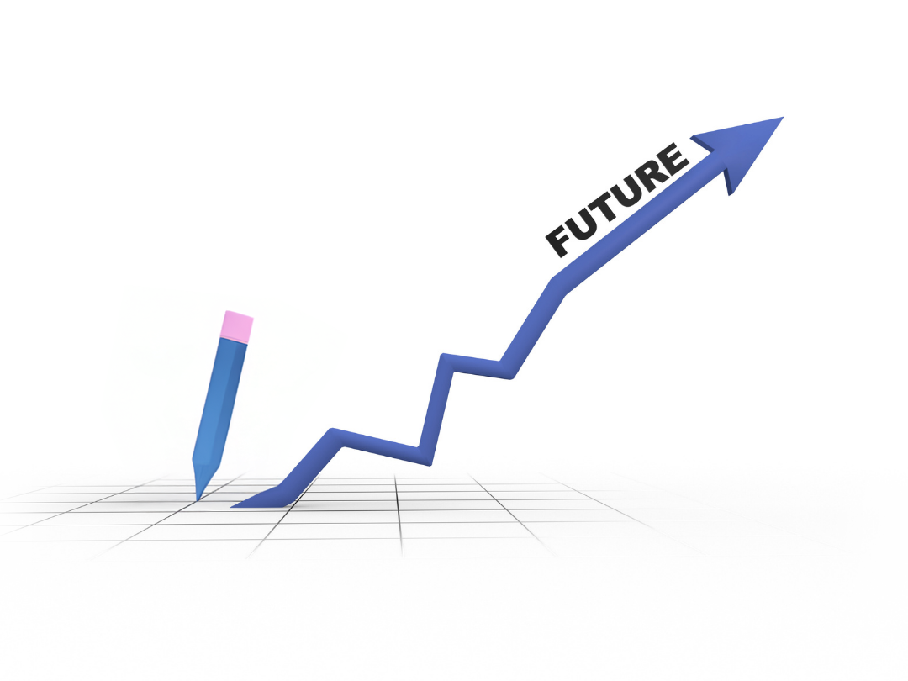
Future Scope
Real-time Analytics: Integrating YouTube Data APIs for live trend analysis.
Multimodal Prompts: Expanding to AI image
and video generation based on dashboard
metrics.
Algorithm Scaling: Applying the workflow to TikTok and Instagram performance datasets.

Slide 11
Thank You
AICW Fellowship | Student Project Presentation 2026
LinkedIn | Edunet Foundation

